Slide 1
Citi Bike Program Data Analysis
Marc Pitarys
Data Analytics Student
20 JUL 2018

Slide 2
Presentation Overview
Background
Data Analysis
Results
Observations

Slide 3
Background
The purpose of this analysis is to measure the performance of the Citi Bike Program in New York City. The data analysis also identifies performance trends, if any, over the subject time span.
Bike ridership data and trip histories were obtained from the Citi Bike System Data Web Site. Analysis was conducted on Data collected over the time period of AUG 2017 to MAY 2018.
A commercial data visualization tool called Tableau was used to analyze approximately 13.4 million records
Observations were made from the visualizations and a interactive dashboard was deployed to allow further investigation of the ridership data

Slide 4
Data Analysis Overview
Approach:
Download CSV files from Citi Bike System Data Web Site
Extract data from CSV files and load into a Panda data frame then create a single CSV file from the data frame
Load the CSV file into Tableau
Using Tableau, create visualizations from the data and store on worksheets
Generate an interactive dashboard from the Tableau worksheets
Make observations and determine any trends from the visualizations
Data Analysis Software Tools/Resources:
Python 3.6
Panda scientific computing library
Jupyter for Python code creation and execution
Tableau Public (Limited to 15 million records)

Slide 5
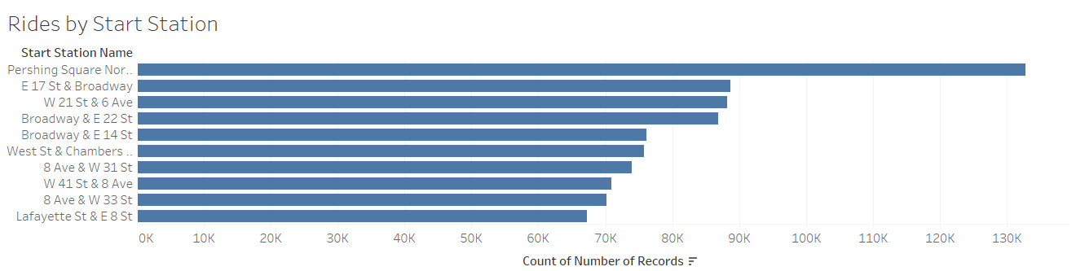
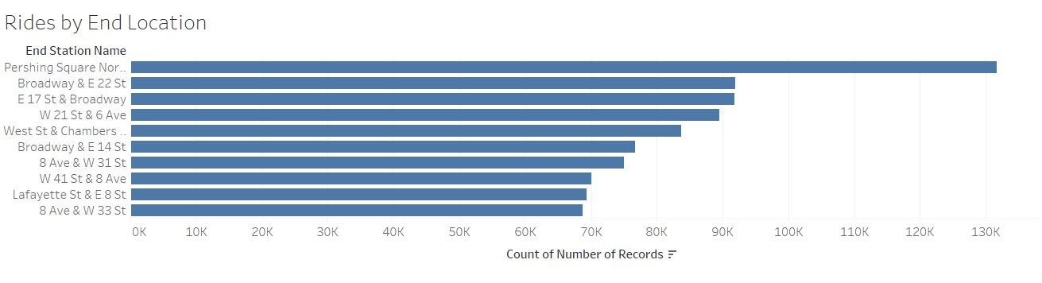
Ridership (AUG 2017 to MAY 2018) Top Ten Stations

Slide 6
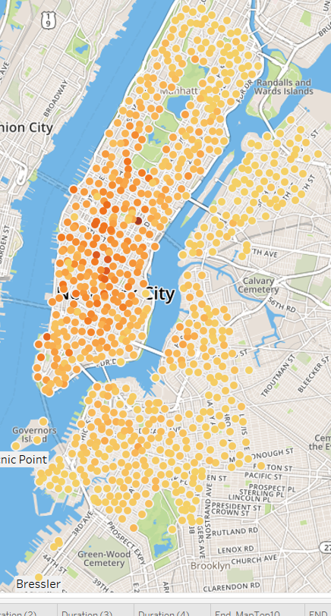
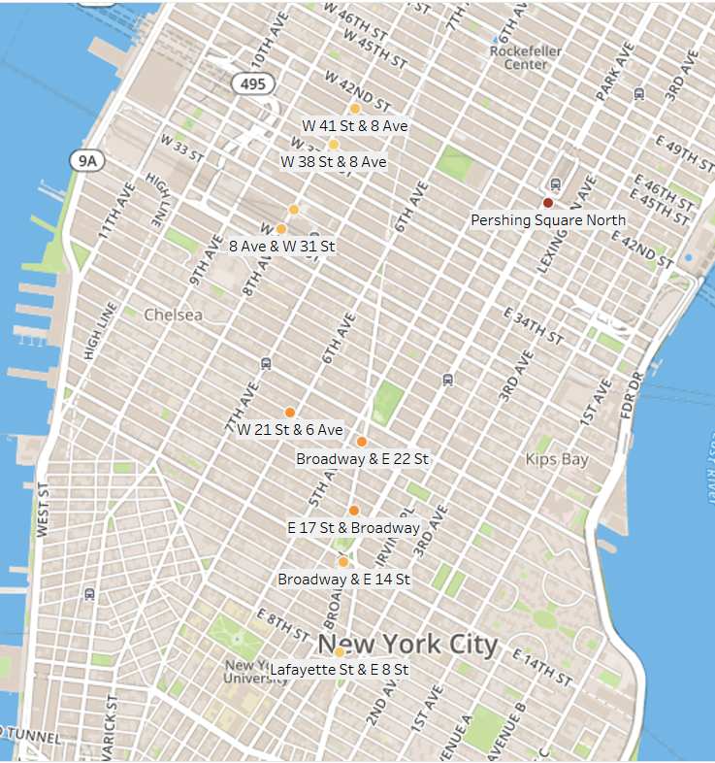
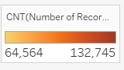
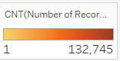
Ridership AUG 2017 to MAY 2018
Start Stations
Ridership AUG 2017 to MAY 2018
Start Stations
Top Ten Start Stations AUG 2017 to MAY 2018
Rides
Rides
Rides

Slide 7
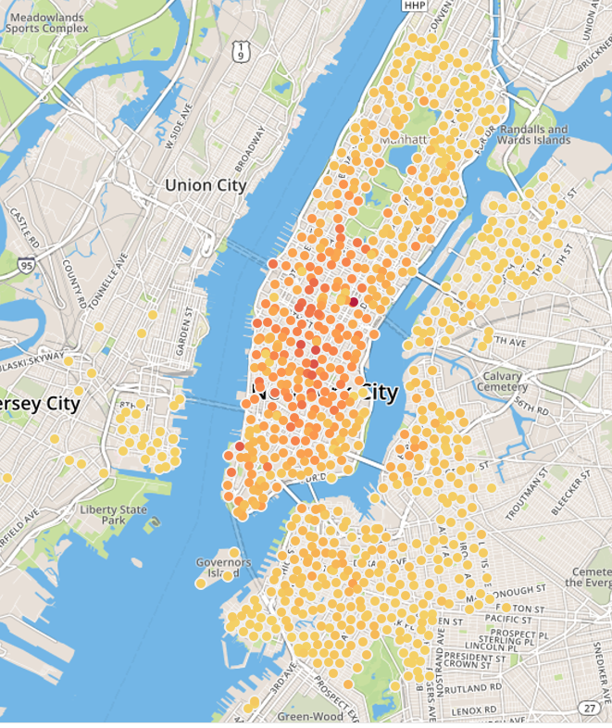
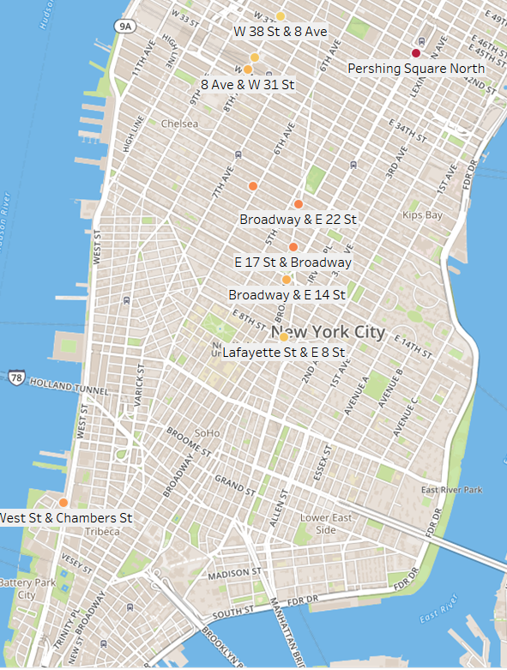
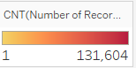
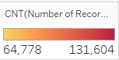
Ridership AUG 2017 to MAY 2018
End Stations
Bikes dropped of in Jersey City
Top Ten End Stations AUG 2017 to MAY 2018
Rides
Rides

Slide 8
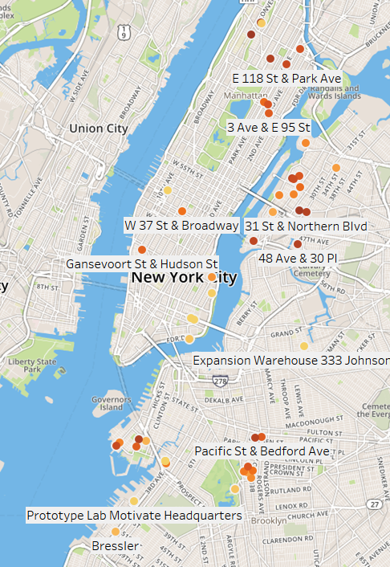
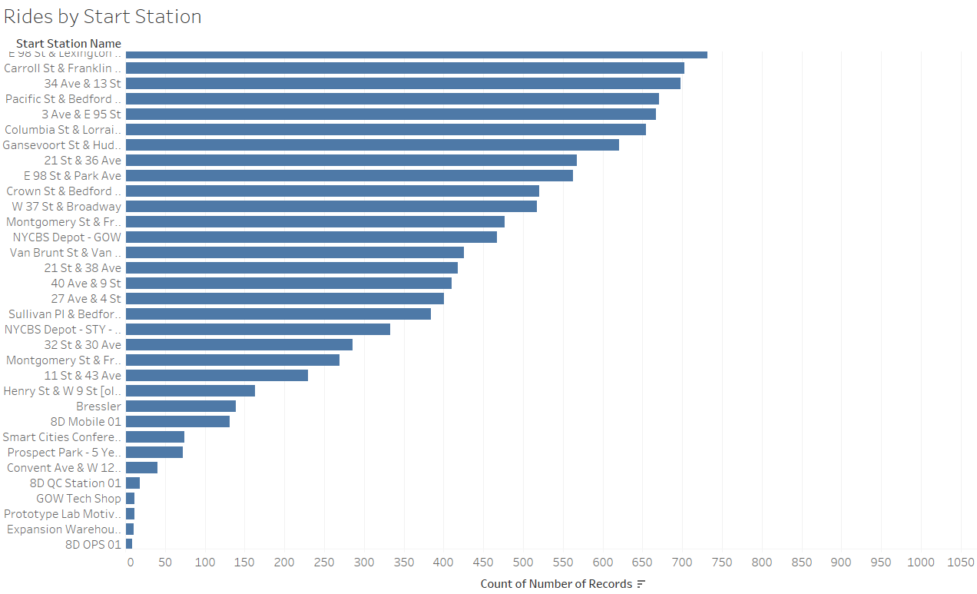
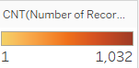
Bottom Performing Stations

Slide 9
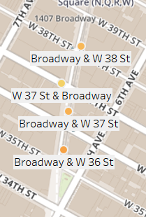
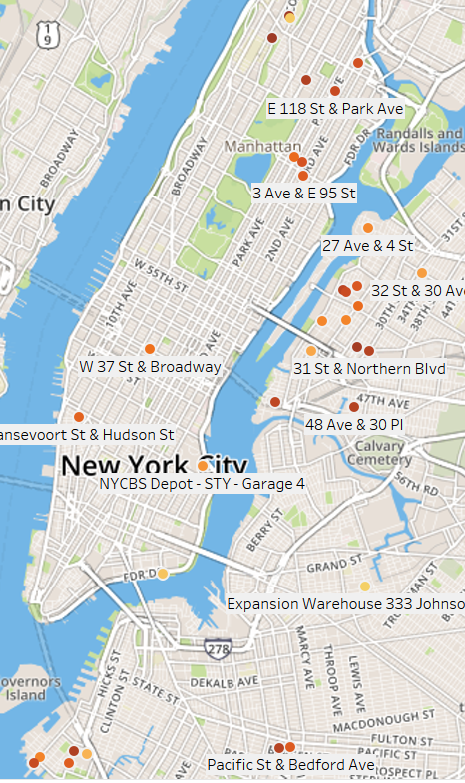
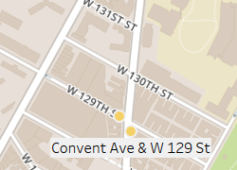
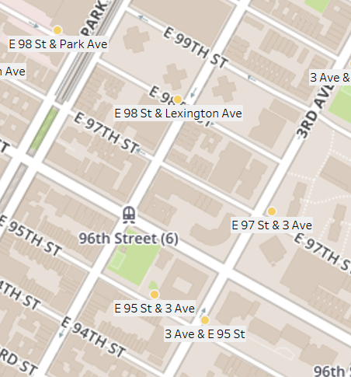
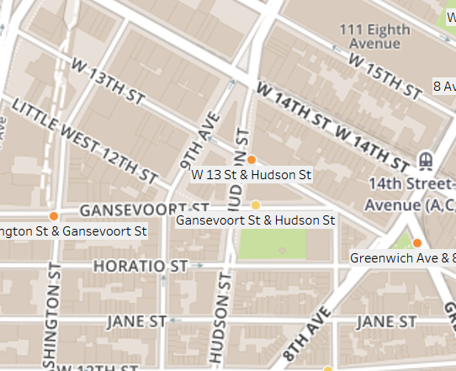
17,768 Rides
1032 Rides
517 Rides
23.225 Rides
41 Rides
563 Rides
32,774 Rides
732 Rides
3334 Rides
667 Rides
42,271 Rides
Proximity of Bottom Performing Stations to High Performing Stations
621 Rides

Slide 10
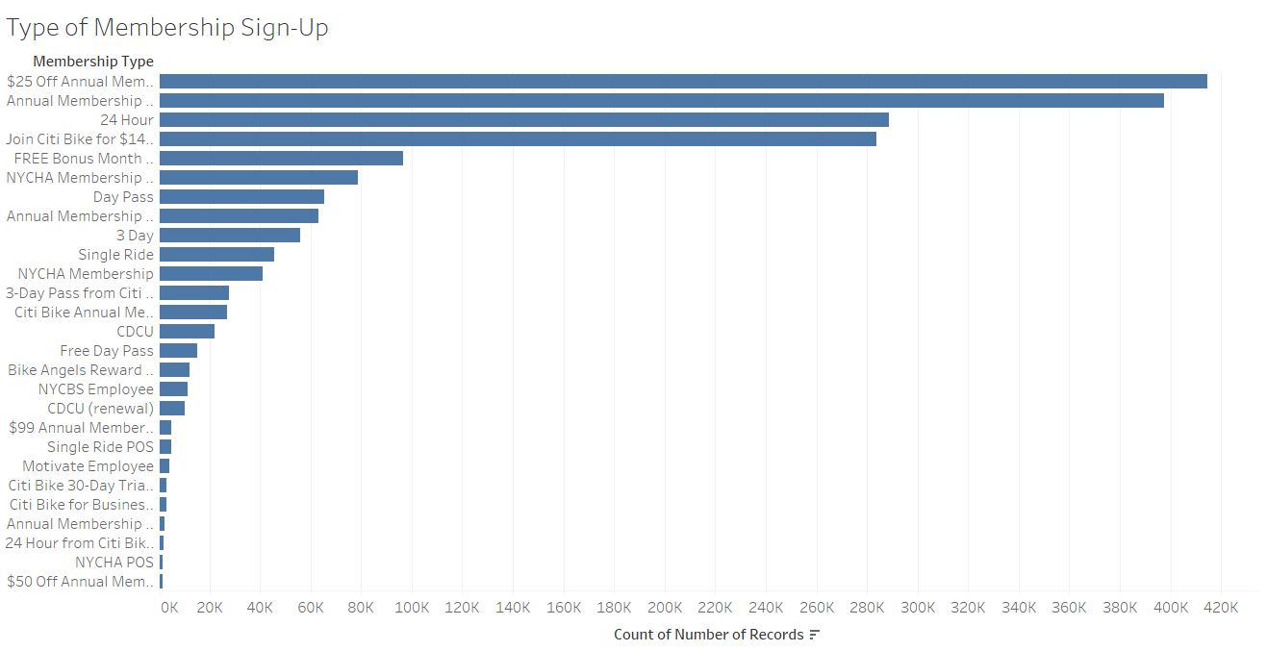
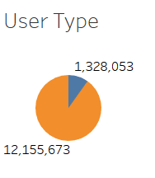
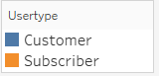
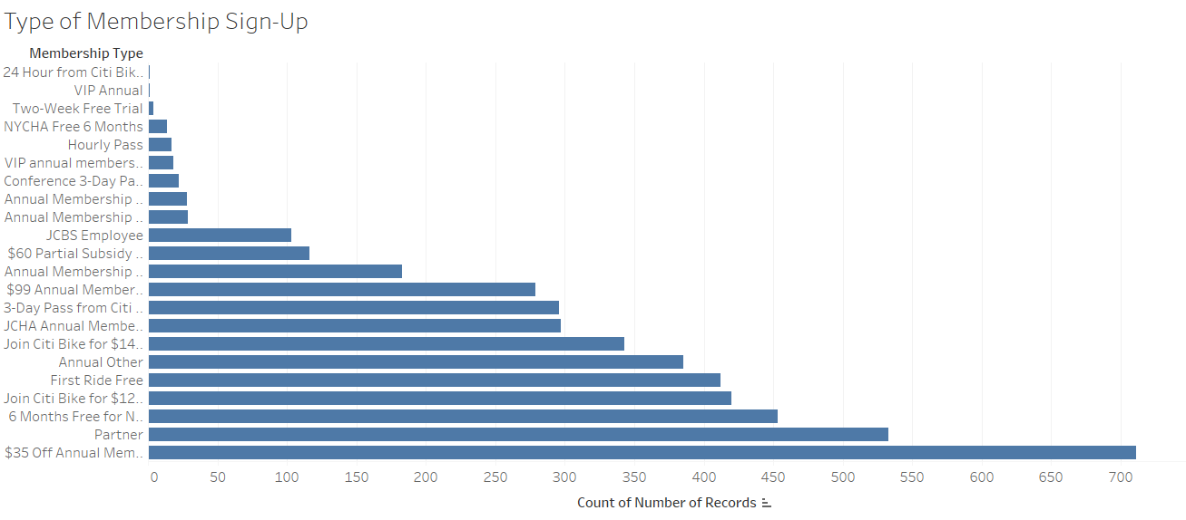
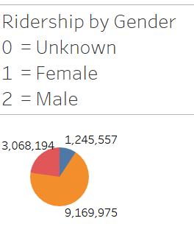
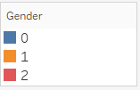
Top Membership Sign-Up Types
Bottom Membership Sign-Up Types

Slide 11
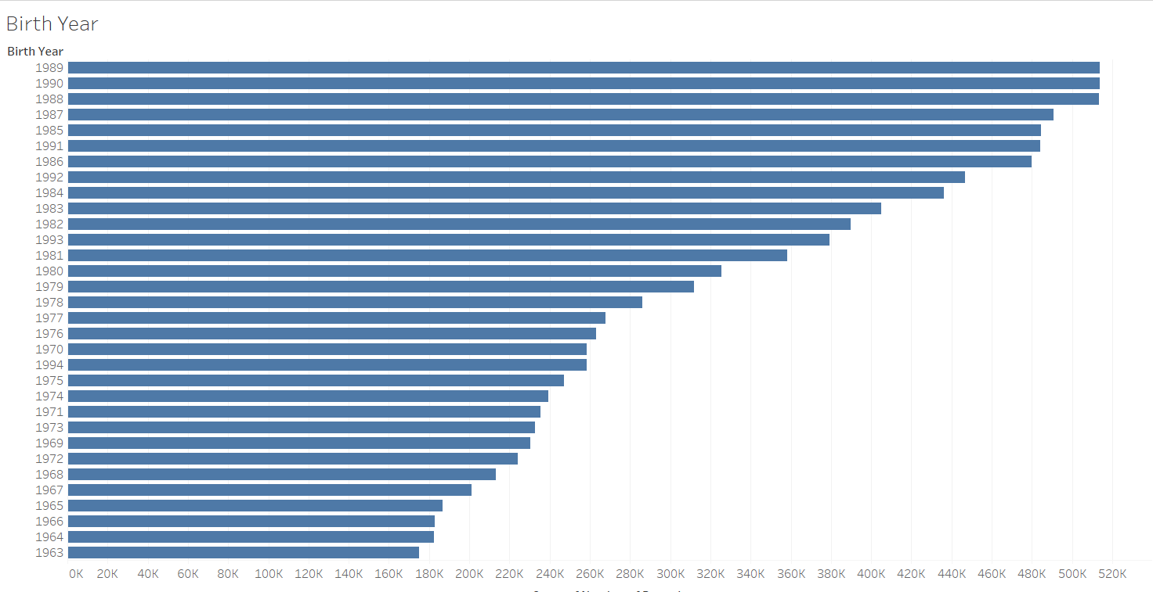
Age of Riders

Slide 12
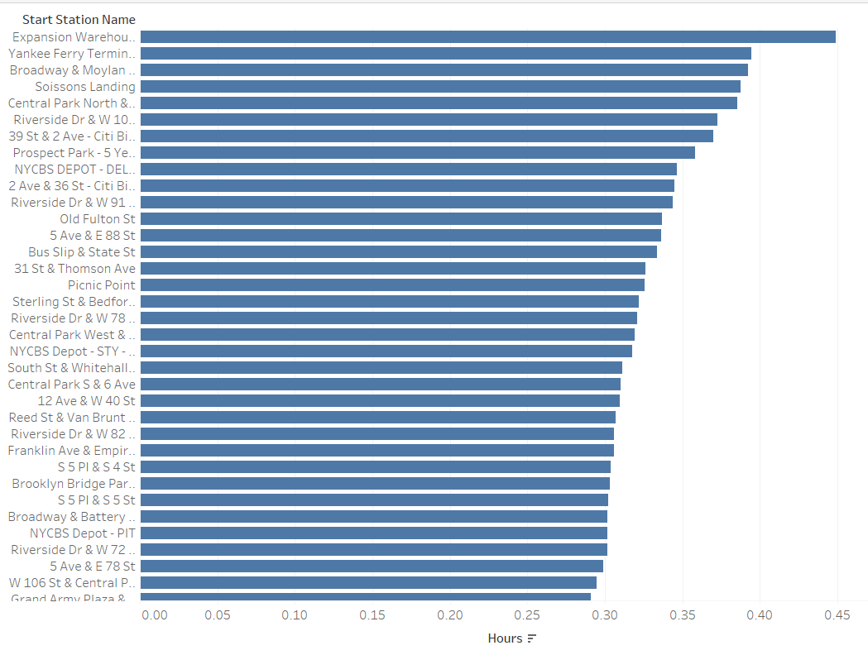
Stations with the Highest Duration Trips

Slide 13
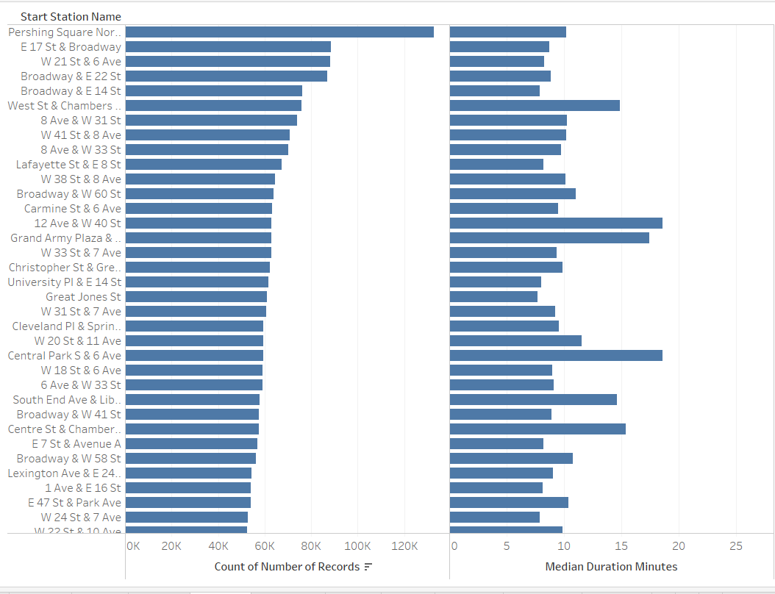
Trip Duration: Highest Performing Stations

Slide 14
Observations
Top stations used to start trips are also the top stations for ending trips. Median time of trips less than 10 mins.
Men outnumber women riders by approximately 3 to 1
Most riders subscribe to the service (12 to 1)
The $25 discount for the annual membership is most popular among riders
Proximity between stations may be contributing to low utilization of some of the worst performing stations
Utilization decreases as the distance from the center of the city increases.

